Slide 1

Introduction to SAP

Slide 2
Who we are…..

Slide 3

A GLOBAL PLAYER IN THE AUTOMOTIVE INDUSTRY
Founded in 1997, Faurecia has grown to become a major player in the global automotive industry. A leader in its four areas of business, the Group is backed by a R&D and production network with sites in 34 countries. It is the preferred partner of the world's largest automakers, which value its operational excellence and technological expertise.
Notes:
Who we are…..

Slide 4
EXPERTISE IN STATE-OF-THE-ART TECHNOLOGY
Faurecia is a pioneer in automotive technology
The Faurecia Group is recognized as a
pioneer in technological innovations
able to reduce the weight of vehicles, offer customized comfort and style solutions, and mitigate any impact on the environment. At the same time, Faurecia is developing new manufacturing processes that are set to revolutionize its production methods.

Slide 5
Why you are here today …..

Slide 6

You are here to continue that legacy of expertise in technology….
SAP is an acronym/ short for…..
Systems
Application and
Products (in data processing)
The world leading provider of business software serving companies like Faurecia. SAP was founded in 1975 by 5 German Engineers.
SAP is a COTS - commercial off-the-shelf ready-made integrated system that is available for sale to the general public.
All SAP modules have the ability to integrate or share data

Slide 7

What will be covered during our time together….
Basic Accounting Principle Terminology
  GAAP : Generally Accepted Accounting Principles
    Example: What does “GL” stand for again?
    What AR or AP mean exactly…..?
Basic SAP Navigation
  Example of SAP screen
FD01 - Creating Customer Master Record
F28 - Account Receivable Posting or Clearing a open invoice

Slide 8

House Keeping
We will have 1 break every hour
Cell phones on mute (NO VIBRATE ☺ )
Write your question down
  It is important and you do not want to forget it. However, most questions are answered as our class time progresses….. If it is not covered then we will have time at the end of class for a Q&A.
Stay calm and take notes…..
  And remember we’re in this TOGETHER!!!!

Slide 9
Terminology……
GAAP: Are accounting standards or rules that are a basic guideline that has been agreed upon by any company operating within the United States. These rules or standards have been defined and sometimes redefined by the professional accounting industry….ie CPA’s and accountants. This is the basis for which we will base our every transaction that you see in SAP to complete our financial statements.
General Ledger or “GL”: A general ledger is a grouping of perhaps hundreds of accounts that are used to sort and store information from a company's business transactions.
The “GL” is organized as follows:
balance sheet accounts (assets, liabilities, equity), and
income statement accounts (revenues, expenses, gains, losses)
As in most businesses operating within the US - the general ledger is expected to have its debit amounts equal to its credit amounts.
http://www.accountingcoach.com/blog/what-is-a-general-ledger-account

Slide 10
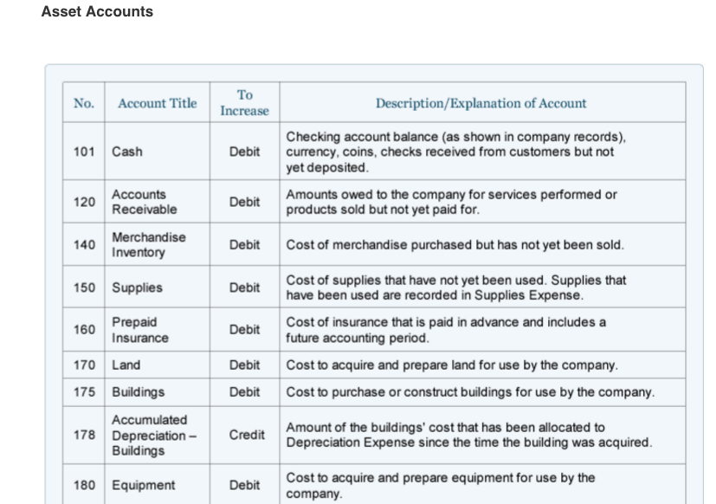
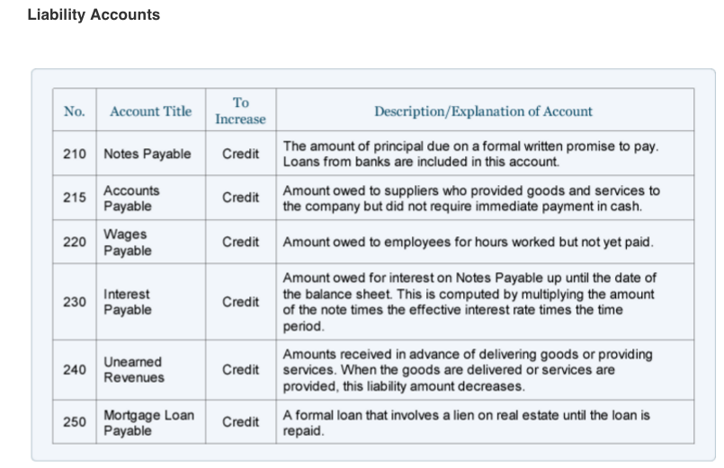
Chart of Accounts – COA : A chart of accounts is a listing of the accounts that a company has available for recording transactions in its general ledger. A company can tailor its chart of accounts to best suit its needs, including adding accounts as needed. In SAP a Chart of accounts has to be assigned to each Company code by using T-Code(Transaction Code) OB62
Sap COA Website …. But more about that later ☺
EXAMPLE OF Chart of Accounts- COA:

Slide 11
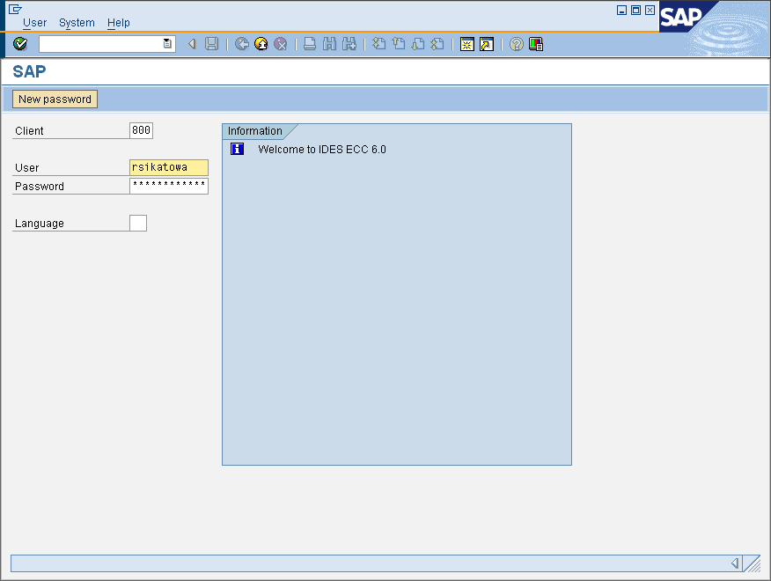
SAP Basic Navigation….
Logging onto the system….

Slide 12
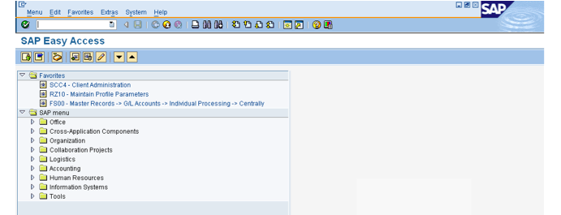
The SAP Easy Access or “Tree”
CNTRL+F will allow you to type in a description of the area within SAP that you are searching

Slide 13
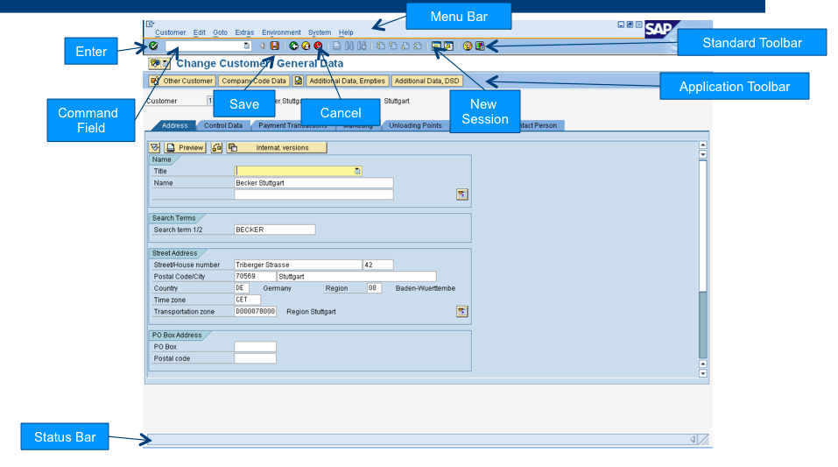
Example SAP screen

Slide 14
STANDARD TOOLBAR FUNCTIONS
- Confirm information entered
- Scroll up to first page
- Enter transaction codes
- Scroll up to previous page
- Save entered information
- Scroll down to next page
- Move to previous screen
- Scroll down to last page
- Exit current area or SAP
- Open a new session
- Cancel or stop current transaction
- Create a desktop shortcut to
SAP report, transaction, or task
- Print
- Find an entry in a screen or table
- Provide SAP help
- Find next instance of same data
- Customize local layout

Slide 15
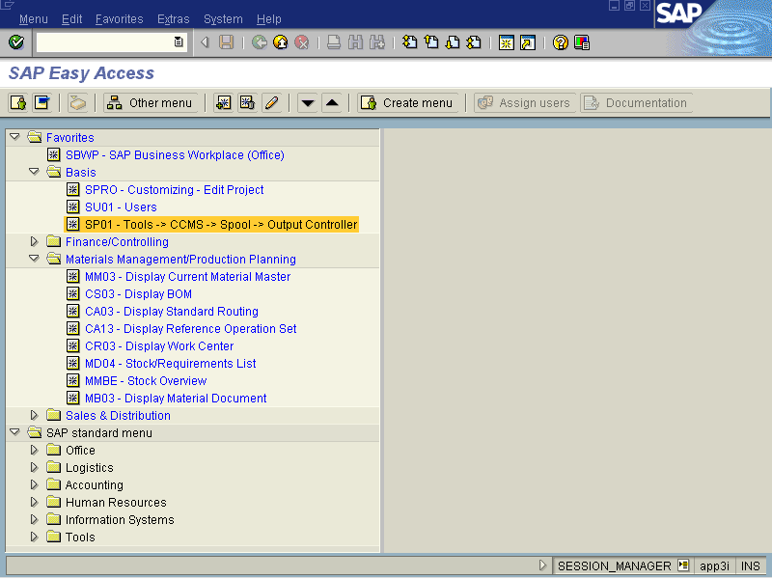
Common Application Icons & Functionality
Add a transaction to the Favorites folder
View previous record in a
transaction
Execute an application, program,
or report
Match code/ pick list/drop down
list of possible values for selected
field
- Create new entries or records
- Copy an existing entry or record
- Change an existing entry or record
- Delete an existing entry or record
- Display/view an existing entry
or record
- Indicates a field is a required field
Application Icons change as the screen changes

Slide 16
STATUS BAR
There are three types of messages that can be displayed depending on the message:
1. Information messages – displayed in green.
    Example
2. Warning messages – displayed in yellow.
    Example
3. Error messages – displayed in red.
    Example

Slide 17
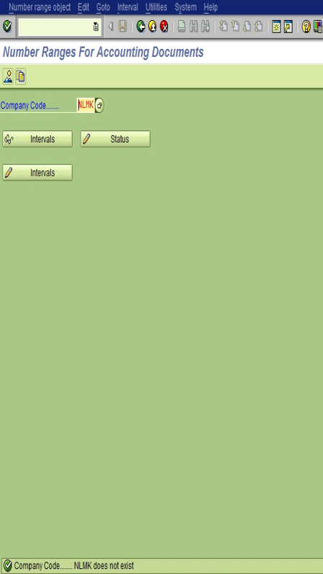
The message area of the status bar displays SAP system
-errors
-warnings
-information messages.
You can double-click directly on a message to obtain more information

Slide 18
FD01-Customer Master Record

Slide 20
Which will be the Account Management tab

Slide 21
A Tolerance is used to deal with differences within payments that are received

Slide 22
F28 - Account Receivable Posting or Clearing a open invoice

Slide 25
Next…..

Slide 26
You did it!!! – The item was correctly posted!!

Slide 27

What WE accomplished together today!!!
Basic Accounting Principle Terminology
  GAAP : Generally Accepted Accounting Principles
    Example: What does “GL” stand for again?
    What AR or AP mean exactly…..?
Basic SAP Navigation
  Example of SAP screen
FD01 - Creating Customer Master Record
F28 - Account Receivable Posting or Clearing a open invoice

